Slide 1
LIBRARY INFORMATION for INTERNATIONAL & EXCHANGE STUDENTS
Fall 2022
Malmö University Library
Notes:
AIntroducera oss själva

Slide 2
WELCOME TO MALMÖ UNIVERSITY LIBRARY!
5 things you should know about the library
Notes:
Kolla om ny film finns, studentsidorna

Slide 3
LEARN MORE ABOUT…
Malmö University Libraries​
Searching the library catalogue
Notes:
A

Slide 4
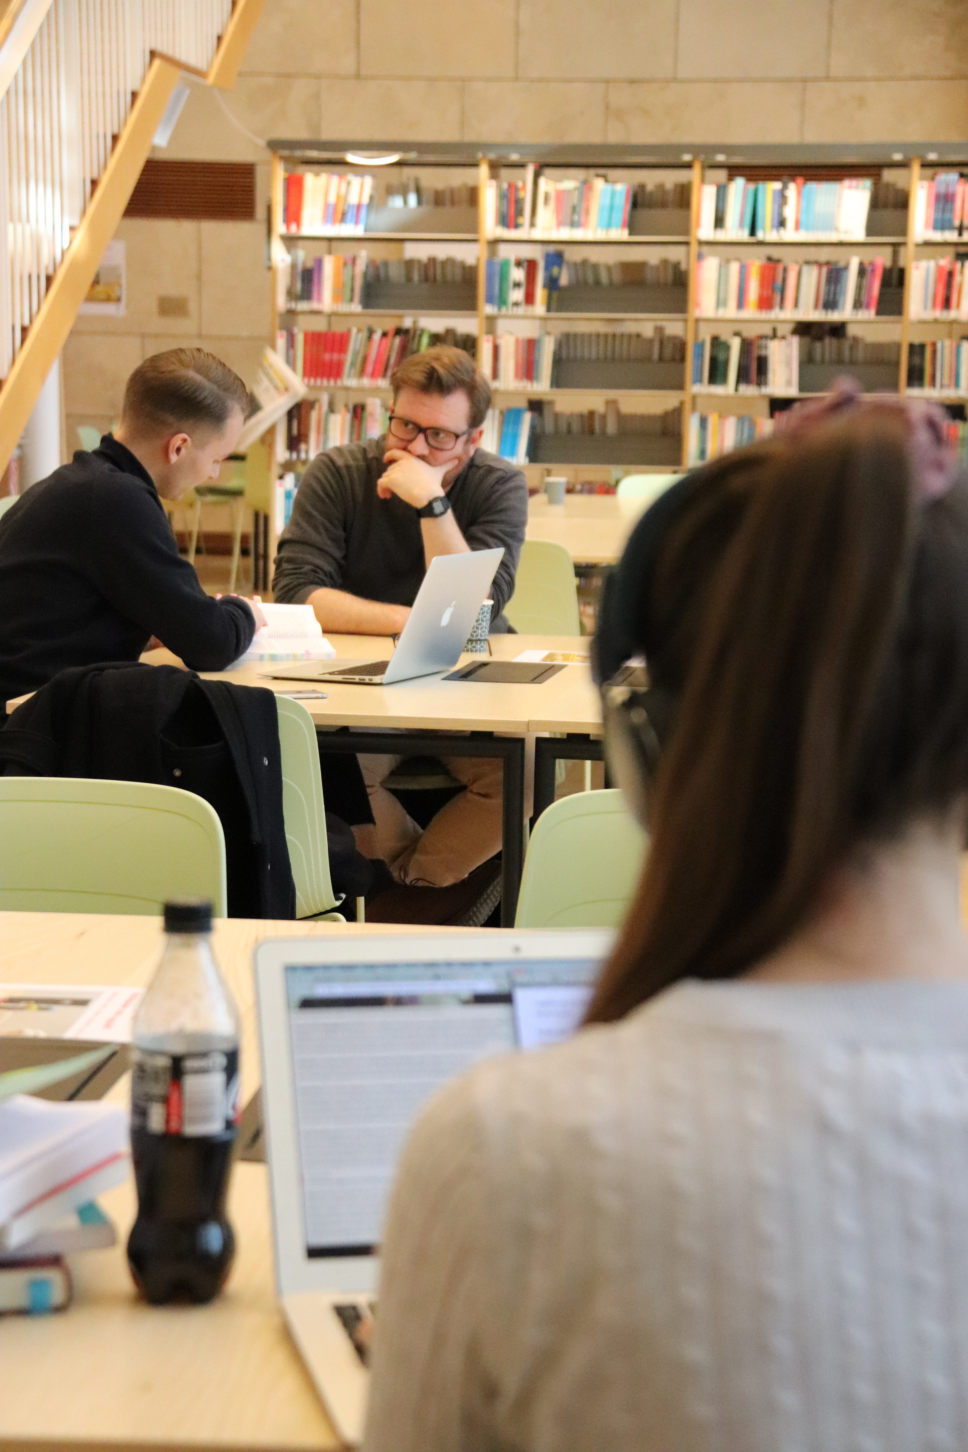
MALMÖ UNIVERSITY LIBRARY…
​…consists of three libraries, all situated within the city of Malmö: Health and Society Library, Odontology Library and Orkanen Library.​

Slide 5
OPENING HOURS:
Orkanen Library:
Mon-Thu | 08:00-20:00
Friday | 08:00-17:00
Saturday | 11:00-16:00
Health & Society Library:
Mon-Fri | 10:00-16:00
Odontology Library:
Mon-Fri | 10:00-14:00
Extended opening hours for students & staff, HS and OD: | All days: 6:00-22:00

Slide 6
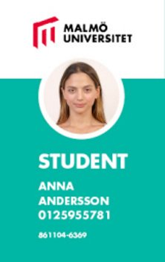
LIBRARY CARD
Your multicard is automatically registered as your library card.
Notes:
K
IT berättar om hur man gör

Slide 7
Our libraries are not traditional quiet libraires – ok to work in groups
Quiet zones​, quiet reading room at Orkanen Library Fika and cold food allowed in the library café, but not hot food.
In the rest of the library eating is not allowed.​
Stationary computers
Printers & photocopiers (scanners)
Wifi
Information desk and IT-support
​
Notes:
A
Vi har 7000 m2 yta, fewer study spaces that usual due to corona. Only one person at a time can use the study rooms at the moment

Slide 8
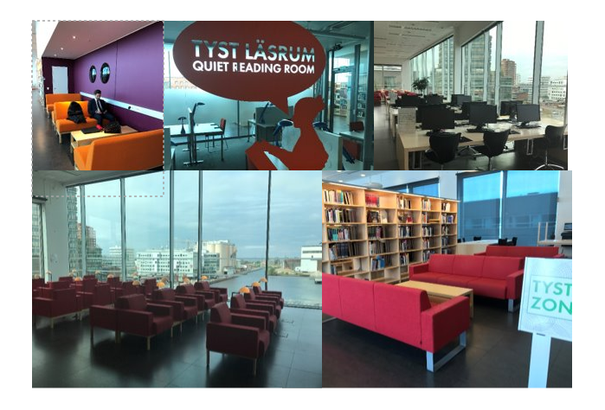
THE STUDY ENVIRONMENT
Notes:
A

Slide 9
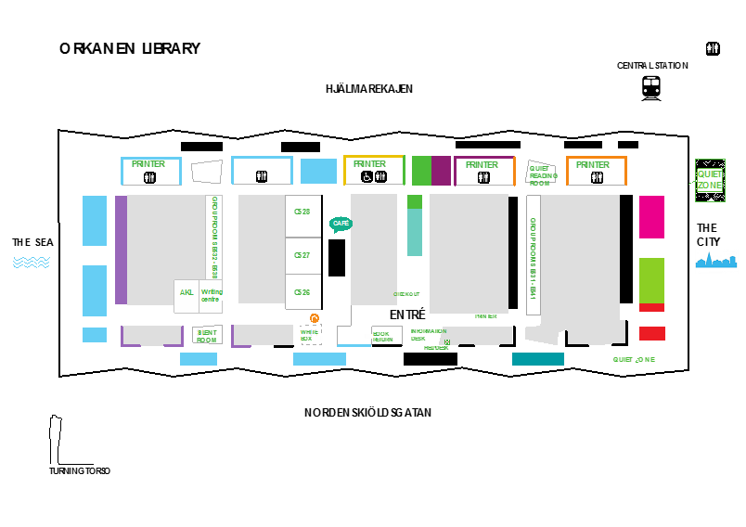
Notes:
A

Slide 10
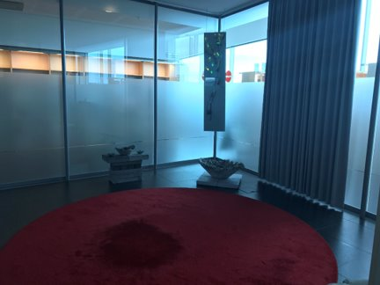
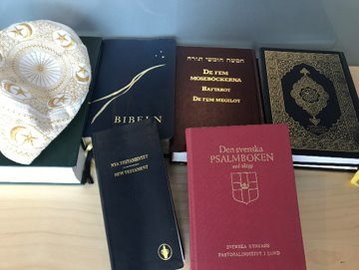
SILENT ROOM
A quiet space for contemplation, meditation and prayer
Notes:
A

Slide 11
BOOK GROUP ROOMS AT ORKANEN LIBRARY
Download the Kronox app or go to the library website to book or confirm your booking.

Slide 12
LIBRARY COLLECTION
Most materials are non-fiction, but you will also find some fiction, newspapers & journals.​
Access to databases, e-books and e-journals – log in with your computer ID.​
All electronic resources are accessible from off-campus​
Our ambition is to have one “library use only” copy for each book on your reading lists. Sometimes that copy is an e-book.
Notes:
K
Refböcker får aldrig lämna biblioteket

Slide 13
LIBRARY REGULATIONS
The check-out period is three weeks. Loans are automatically renewed 7 times, unless someone places a hold on the material, in which case you'll be notified by email.
Borrowers who return items after the due date are fined 10 SEK per item and day. If a borrower has unpaid fines of 100 SEK or more, they may not borrow, renew or request items until the fines are paid.
Check your loans at https://lib.mau.se/patroninfo
Notes:
K

Slide 14
FINDING BOOKS AND ARTICLES​ www.mau.se/en/library
Notes:
K
Visa lajv
academic writing bailey
Easiest to search for title, not author
If you need help finding the right shelf, please let us know!

Slide 15
LIBRARY SERVICES
General questions – chat, e-mail, phone
Search consultation – if you need help searching for sources for an assignment or a research project you can book a free individual 1 hour session of guided information seeking​ with a librarian
Inter-library loans – the library offers an inter-library loan service to provide access to material which is not in stock locally.​
Book suggestions – suggest a book, journal or other materials for purchase
Notes:
K
Lämna gärna inköpsförslag!​ -vi avgör om blir inköp eller ill
Nämn chatten – efter corona är vi bra på det

Slide 16
TALKING BOOKS
Students with a reading disability, for example dyslexia, ADHD, or a visual impairment can borrow course literature as talking books.
Book an appointment to get started at our website: https://mau.se/en/library/guides-and-support/talking-books/
All students can also download assistive software, such as text to speech programs and spell checkers.
Notes:
K
Betona att detta BARA är för studenter som har någon typ av läsnedsättning, INTE för alla

Slide 17
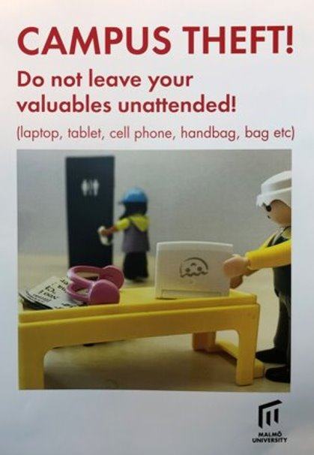
Do not
leave your
valuables
unattended
in the library!
Notes:
A

Slide 18
THE STUDENT ART GALLERY
Last date of application: October 23
​
The Student Art Gallery at Orkanen Library is an inspiring element in the study environment and a place for dialogue and contemporary documentation.​
Since the start of the Student Art Gallery in 2008 over 200 students and staff at Malmö University has exhibited their paintings, photos and films.
Notes:
A
Läs mer på bibliotekets hemsida​
​
Berätta om Reserachers Gallery – find out more about ongoing research at the university in our exhibition area.

Slide 19
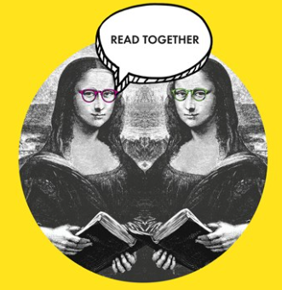
START A BOOK CLUB
Gather a group of 5-6 people and borrow a book club bag.
The books you can choose between are:
Maja Lunde's The End of the Ocean
Jacqueline Woodson's Red at the Bone
The bag also contains an author portrait, suggestions on how to set up your meetings, and discussion questions.
Borrow the book club bag for 4 weeks. We are happy to help you book a room at the Orkanen Library if needed.
Sign up your group to: pernilla.frojdh@mau.se
Notes:
K

Slide 20
VISIT MALMÖ PUBLIC LIBRARY
Notes:
K
Feature films, streaming service​
Newspapers in different languages​
Fiction in different languages
Free to get a library card

Slide 21
Thank you!
Visit us at:
https://mau.se/en/library/
Notes:
K

