Slide 1
Thinking & Writing Academically

Slide 2
The Writing Centre
This Photo by Unknown Author is licensed under CC BY

Slide 3
The Writing Centre
instructions and help to clarify tasks
the writing process and the development of reasoning
text and sentence structure and context
bibliography and source management
grammar
reading

Slide 4
The Writing Centre
instructions and help to clarify tasks
the writing process and the development of reasoning
text and sentence structure and context
bibliography and source management
grammar
reading

Slide 5
The Writing Centre
instructions and help to clarify tasks
the writing process and the development of reasoning
text and sentence structure and context
bibliography and source management
grammar
reading

Slide 6
The Writing Centre
instructions and help to clarify tasks
the writing process and the development of reasoning
text and sentence structure and context
bibliography and source management
grammar
reading

Slide 7
The Writing Centre
instructions and help to clarify tasks
the writing process and the development of reasoning
text and sentence structure and context
bibliography and source management
grammar
reading

Slide 8
The Writing Centre
instructions and help to clarify tasks
the writing process and the development of reasoning
text and sentence structure and context
bibliography and source management
grammar
reading

Slide 9
The Writing Centre
instructions and help to clarify tasks
the writing process and the development of reasoning
text and sentence structure and context
bibliography and source management
grammar
reading

Slide 10
The Writing Centre via The student Web

Slide 11
This Photo by Unknown Author is licensed under CC BY-SA-NC

Slide 12
Different ways of incorporating sources
Quote sources
Include the actual language of your source into your own paper (with quotation marks)
Paraphrase
Reproduce an idea from a source but translate it into your own words (about the same length as the original)
Summarize
Condense the source by keeping main ideas and omitting detail

Slide 13
Different ways of incorporating sources
Quote sources
Include the actual language of your source into your own paper (with quotation marks)
Paraphrase
Reproduce an idea from a source but translate it into your own words (about the same length as the original)
Summarize
Condense the source by keeping main ideas and omitting detail

Slide 14
Different ways of incorporating sources
Quote sources
Include the actual language of your source into your own paper (with quotation marks)
Paraphrase
Reproduce an idea from a source but translate it into your own words (about the same length as the original)
Summarize
Condense the source by keeping main ideas and omitting detail

Slide 15
Different ways of incorporating sources
Quote sources
Include the actual language of your source into your own paper (with quotation marks)
Paraphrase
Reproduce an idea from a source but translate it into your own words (about the same length as the original)
Summarize
Condense the source by keeping main ideas and omitting detail

Slide 16
to avoid plagiarism
Use your own words and sentence structure when you paraphrase.
A paraphrase should capture a specific idea from a source but must not duplicate the writer's phrases and words.
This Photo by Unknown Author is licensed under CC BY-SA-NC

Slide 17
Your documentation must be both thorough and correctly placed - two parts:
to cite - in-text citation
to name the author’s last name, the year, the page number; this is the short reference you give in the body of your paper after you quote, paraphrase, or refer to something someone else has said:
(Gray, 2020: 49)
reference list, works cited list
this is the long reference list at the end of a paper that gives all the details of your sources, such as the author, titles, dates, publishers, etc.

Slide 18
Your documentation must be both thorough and correctly placed - two parts:
to cite - in-text citation
to name the author’s last name, the year, the page number; this is the short reference you give in the body of your paper after you quote, paraphrase, or refer to something someone else has said.
reference list - works cited list
this is the long reference list at the end of a paper that gives all the details of your sources, such as the author, titles, dates, publishers, etc.
Gray, A. (2020). Digital Formative Feedback. The Journal of Teaching and Learning, vol.2 , iss. 1, np. http://DOI.ojs.mau.se/index.php/JoTL/article/view/58.

Slide 19
Lead-in Phrases and in-text citation
According to Gray (2020), plagiarism can be can be avoided by remembering to keep track of all sources, rewriting the original text with original grammar and vocabulary, and refering to all source material with in-text citations and a reference list at the end of the paper (cited in Svensson, 2021).

Slide 20
Paragraph structure to avoid plagiarism
Start a paragraph with your idea/opinion that you want to prove. (SUBJECTIVE)
Then give a summary or paraphrase of your source to prove your point, with an in-text citation of the course. (OBJECTIVE)
Then give YOUR evaluation or explanation of the evidence your source presented. (SUBJECTIVE)

Slide 21
STUDYING IN SWEDEN part 3
Web Portals:
CANVAS
Kronox
LADOK student

Slide 22
As a student, you will need access to three student web portals:
CANVAS (your course portal)
KronoX (your schedule)
LADOK Student (registration, exam grades, transcripts)
All are available on the front page of the Student Web Portal: student.mau.se/en/

Slide 23
How to access the Student Web Portals
FIRST: get your computer ID and Password:
If you have problems, please contact helpdesk in the Orkanen Library.

Slide 24
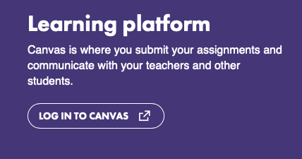
Student Web Portals: CANVAS
Canvas is an e-learning platform for each individual course, where you will automatically be a member after you register, BUT you need your computer ID first.

Slide 25
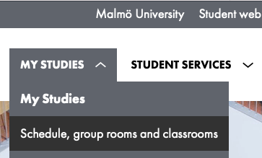
Student Web Portals: KronoX
You can…
find your schedule online and download the schedule to your phone via iCal.
book a study room via the KronoX app.

Slide 26
Student Web Portals: KronoX
Schedules will appear online 4 weeks before a course begins (not a program).
It’s possible that you can see your program schedule for the first course only

Slide 27
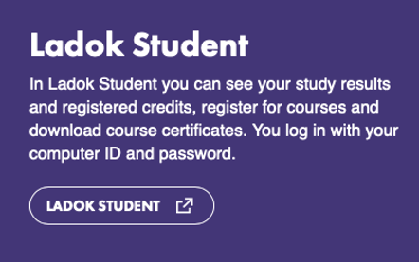
Student Web Portals: LADOK Student
LADOK STUDENT is where you can
pre-register for your courses
see your study results, and
download certified study certificates.
PLEASE NOTE: you MUST register in the programme or courses you have been admitted to OR YOU WILL NOT BE A STUDENT IN THAT PROGRAM / COURSE.

Slide 28
English Grading Scales
A, B, C, D, E, U
U = fail
U or G
U = fail
G = pass
Notes:
Grades
English based programs use the following scale:

Slide 29
Q&A

